Slide 1
Signal Recovery Under Perturbations
Eeshan Malhotra, 14305R001
Under the guidance of
Prof. Ajit Rajwade
Department of Computer Science and Engineering, IIT Bombay
Dr. Karthik Gurumoorthy
Amazon Development Centre & ICTS Bangalore

Slide 2
Outline
Introduction
Perturbation in sensing matrix
Problem definition, algorithm and experimental results
Tomographic reconstruction with unknown angles
Problem definition, algorithm and experimental results
Interference among two sparse signals
Framework for improving recovery guarantees

Slide 3

Introduction: Compressed Sensing Framework
$y= Φx$
or, $y= ΦΨθ$
Measurement
Mx1
Sensing matrix
MxN
Basis
NxN
Sparse Signal Representation
Nx1
M < N
Typical scenario: $y$, $Φ$, $Ψ$ are known. Recover $θ$ (or $x$).
$$\min_{x}{||y −Φx {||}_{2}^{2}\text{+ }λ}|\left|x\right||_{1}$$
In practice: Any of $y$, $Φ$, $Ψ$ may have inaccuracies, or perturbations, or even simply structural properties known
Notes:
Alternative being the constrained formulation of the problem

Slide 4
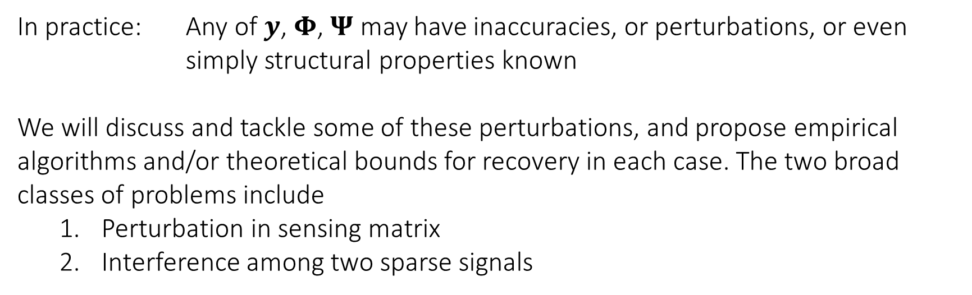

Introduction: Compressed Sensing Framework
$y= Φx$
$$\min_{x}{||y −Φx{||}_{2}^{2}\text{+ }λ}|\left|x\right||_{1}$$
In practice: Any of $y$, $Φ$, $Ψ$ may have inaccuracies, or perturbations, or even simply structural properties known
We will discuss and tackle some of these perturbations, and propose empirical algorithms and/or theoretical bounds for recovery in each case. The two broad classes of problems include
Perturbation in sensing matrix
Interference among two sparse signals

Slide 5
Perturbed Sensing Matrix
Section 1

Slide 6
Perturbed Sensing Matrix
Sensing matrix 𝚽 may have inaccuracies
Sources: Calibration error, relative motion between instrument and sample
E.g.: Frequencies of Fourier sensing matrix in MRI being off by a small amount, tomography projection angles being imperfectly known, etc.
Because of its widespread use, we consider the Fourier sensing matrix for measurement
The framework developed is more general in applicability than the specific cases mentioned

Slide 7
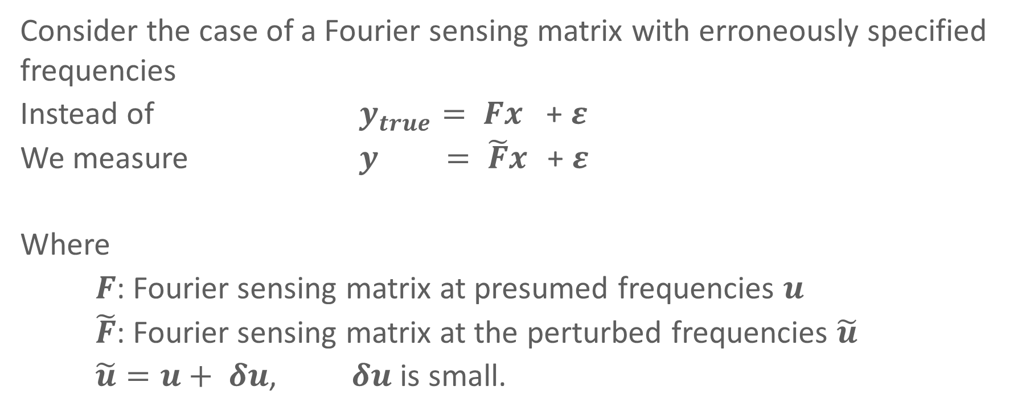
Perturbed Sensing Matrix
Consider the case of a Fourier sensing matrix with erroneously specified frequencies
Instead of $y_{true}= Fx$ + $ε$
We measure $y = \tilde{F}x$ + $ε$
Where
$F$: Fourier sensing matrix at presumed frequencies $u$
$\tilde{F}$: Fourier sensing matrix at the perturbed frequencies $\tilde{u}$
$\tilde{u}=u+ δu$, $δu$ is small.

Slide 8
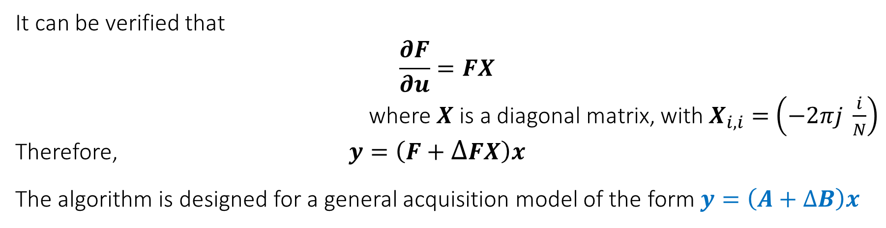
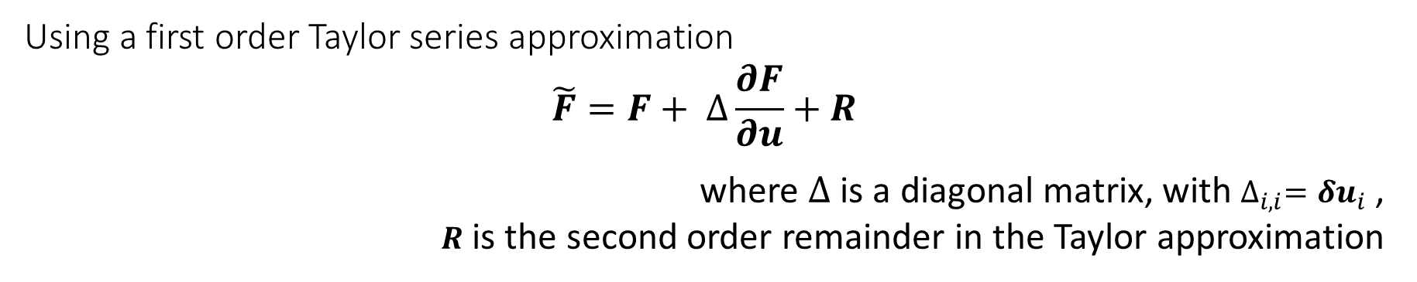
Perturbed Sensing Matrix: Framework
Using a first order Taylor series approximation
$$\tilde{F}=F+ ∆\frac{∂F}{∂u}+R$$
where $∆$ is a diagonal matrix, with $∆_{i,i}={δu}_{i}$ ,
$R$ is the second order remainder in the Taylor approximation
It can be verified that
$$\frac{∂F}{∂u}=FX$$
where $X$ is a diagonal matrix, with $X_{i,i}=$ $\left(−2πj \frac{i}{N}\right)$
Therefore, $y=\left(F+∆FX\right)x$
The algorithm is designed for a general acquisition model of the form $y=\left(A+∆B\right)x$

Slide 9
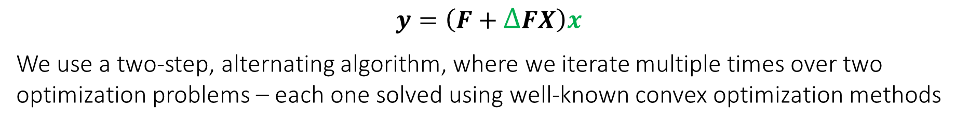
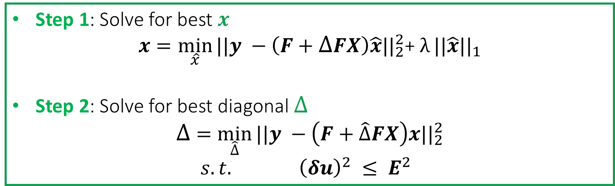
Perturbed Sensing Matrix: Algorithm
$$y=\left(F+∆FX\right)x$$
We use a two-step, alternating algorithm, where we iterate multiple times over two optimization problems – each one solved using well-known convex optimization methods
Step 1: Solve for best $x$
$$x=\min_{\hat{x}}{||y −\left(F+∆FX\right)\hat{x}{||}_{2}^{2}\text{+ }λ}||\hat{x}||_{1}$$
Step 2: Solve for best diagonal $∆$
$$∆ =\min_{\hat{∆}}{||y −\left(F+\hat{∆}FX\right)x{||}_{2}^{2}}$$
$s.t. {\left(δu\right)}^{2} ≤ E^{2}$
Where $E^{2}$ is an upper bound on the magnitude of the perturbations (a constant vector, containing the same value $E_{max}$ in each element)
Notes:
Initialize \delta to 0
Iterate till convergence

Slide 10

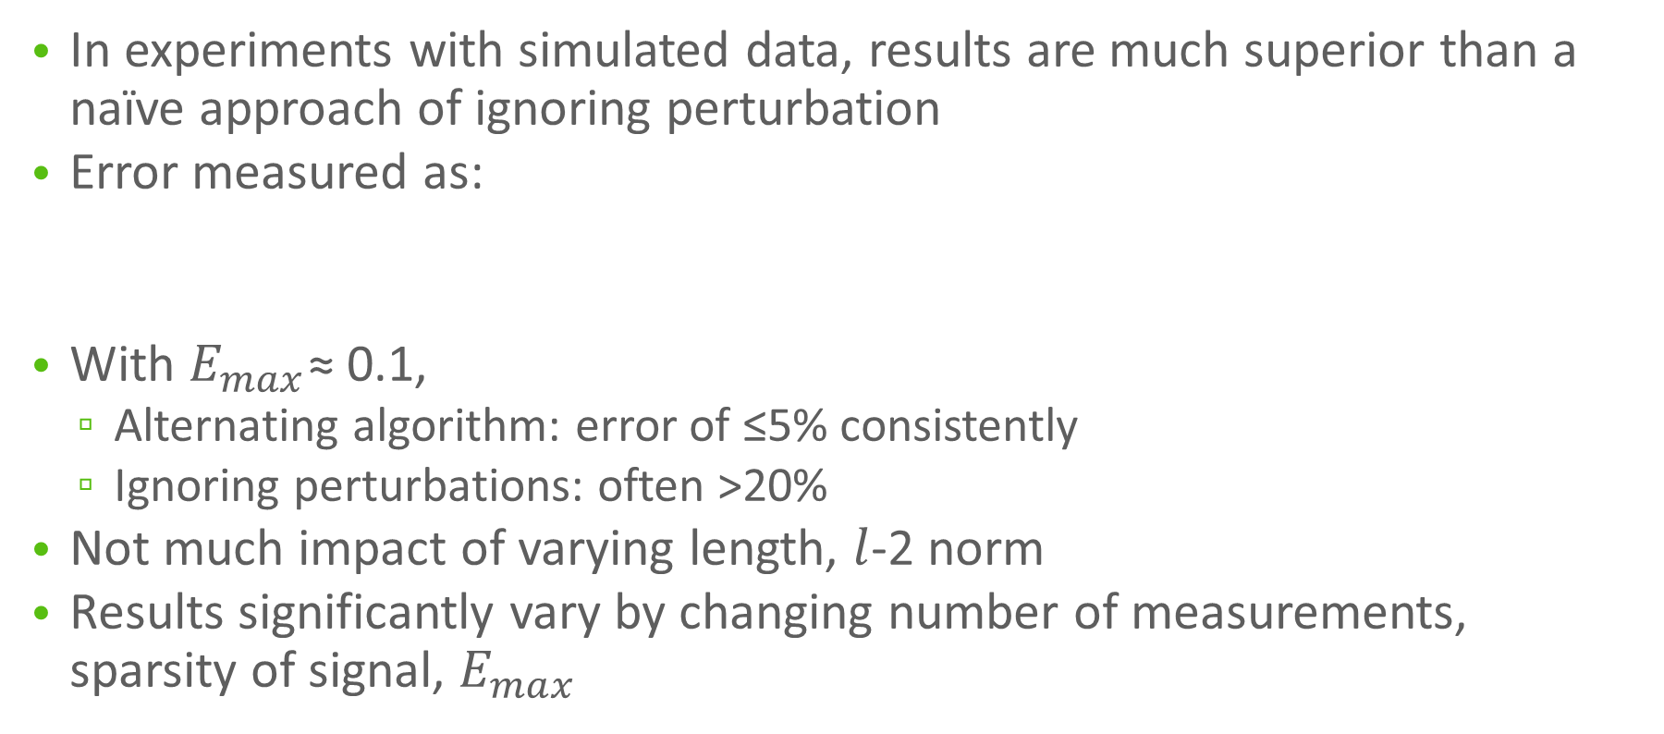
Perturbed Sensing Matrix: Results
In experiments with simulated data, results are much superior than a naïve approach of ignoring perturbation
Error measured as:
With $E_{max}$≈ 0.1,
Alternating algorithm: error of ≤5% consistently
Ignoring perturbations: often >20%
Not much impact of varying length, $l$-2 norm
Results significantly vary by changing number of measurements, sparsity of signal, $E_{max}$

Slide 11
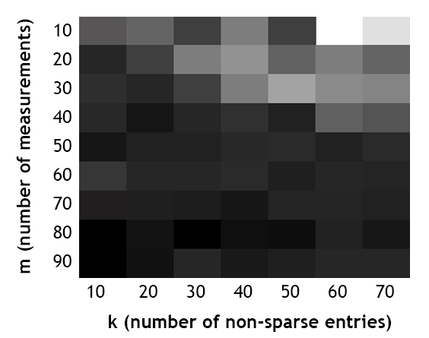
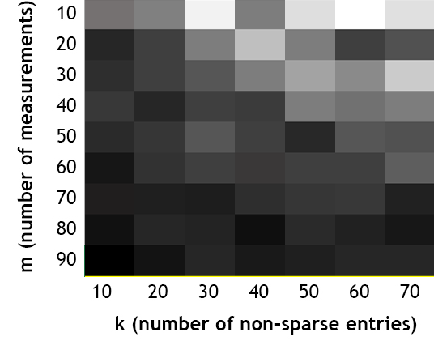
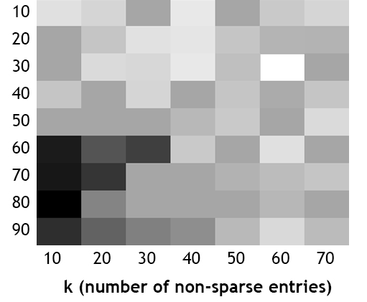



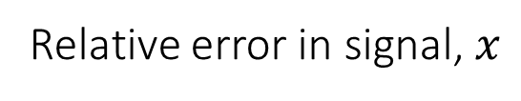
Perturbed Sensing Matrix: Results
Relative error in signal, $x$
Darker cells denote lower fractional error.
Min error: 2.5%; Max error: 95%
$$E_{max}=0.01$$
$$E_{max}=0.1$$
$$E_{max}=0.5$$

Slide 12

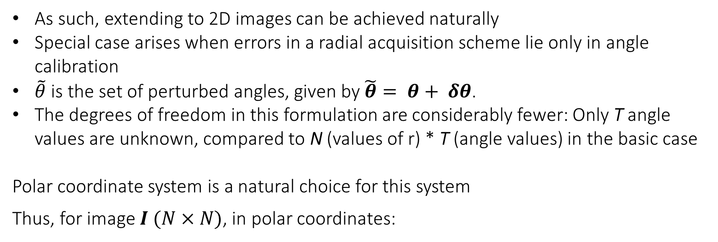
Perturbed Sensing Matrix: 2D recovery
As such, extending to 2D images can be achieved naturally
Special case arises when errors in a radial acquisition scheme lie only in angle calibration
$\tilde{θ}$ is the set of perturbed angles, given by $\tilde{θ}= θ+ δθ$.
The degrees of freedom in this formulation are considerably fewer: Only T angle values are unknown, compared to N (values of r) * T (angle values) in the basic case
Polar coordinate system is a natural choice for this system
Thus, for image $I (N×N)$, in polar coordinates:
Notes:
Talk about the error in frequencies becoming large even if error in \theta is small

Slide 13
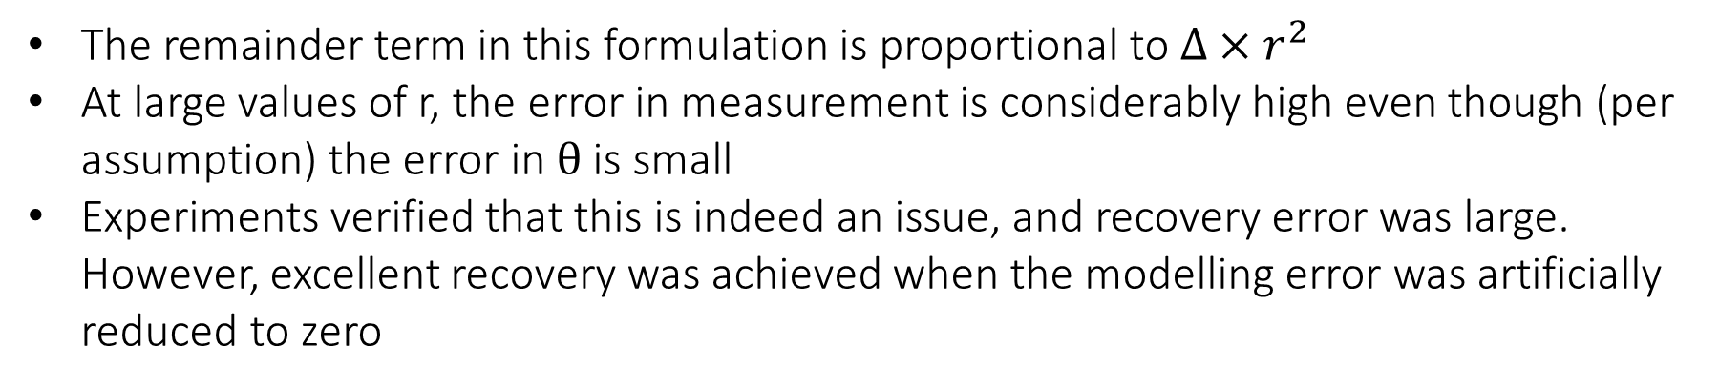
Perturbed Sensing Matrix: 2D recovery
Again, using a Taylor’s series approximation,
Which is also gives an acquisition model of the form $y ≈(A+ ∆B)x$
The remainder term in this formulation is proportional to $∆×r^{2}$
At large values of r, the error in measurement is considerably high even though (per assumption) the error in $θ$ is small
Experiments verified that this is indeed an issue, and recovery error was large. However, excellent recovery was achieved when the modelling error was artificially reduced to zero
Notes:
Talk about the error in frequencies becoming large even if error in \theta is small

Slide 14
Perturbed Sensing Matrix: Future Work
Proposed Solutions (Yet to be investigated)
Only use measurements in the low r range in the alternating algorithm. Once the angle estimates converge, utilize all available measurements to re-estimate the signal
Pooling method: Use multiple signals measured with the same angle perturbations. This increases the number of available data points (measurements), while increasing the number of unknowns by a smaller amount (sparse signals to be recovered)
Other avenues of future work
Theoretically prove the uniqueness and/or bound the error in the solution obtained by the presumed model, possibly using a lifting scheme

Slide 15
Tomographic Recovery with Unknown View Angles
Section 2

Slide 16
Unknown View Angles: Motivation
In computed tomography, an extreme case of sensing matrix being erroneously known is when view-angles for projections are completely unknown
Eg: Cryo-electron microscopy, and to a lesser degree, patient motion in medical CT
However it has been shown by Basu & Bresler (2000), that under modest assumptions, the image is still uniquely determined by the set of projections (up to a global rotation and reflection ambiguity)
Existing work (Coifman et al (2008), Fang et al (2010), Fang et al (2011)) typically -
Produces an ordering for projections (often using dimensionality reduction), and assumes a distribution to determine values of angles
Requires an extremely large number of angles for the recovery to be stable
Notes:
Describe tomography basics? Fourier slice theorem

Slide 17
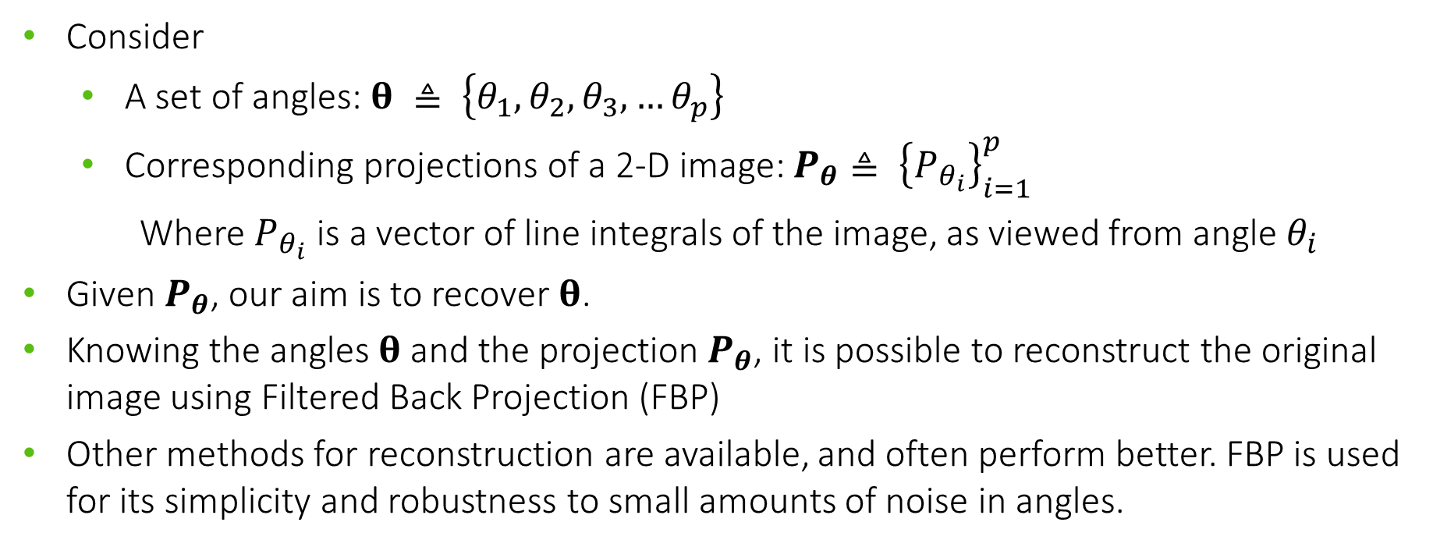
Unknown View Angles: Problem Statement
Consider
A set of angles: $θ ≜ \left\{θ_{1},θ_{2},θ_{3},…θ_{p}\right\}$
Corresponding projections of a 2-D image: $P_{θ}≜ {\left\{P_{θ_{i}}\right\}}_{i=1}^{p}$
Where $P_{θ_{i}}$ is a vector of line integrals of the image, as viewed from angle $θ_{i}$
Given $P_{θ}$, our aim is to recover $θ$.
Knowing the angles $θ$ and the projection$P_{θ}$, it is possible to reconstruct the original image using Filtered Back Projection (FBP)
Other methods for reconstruction are available, and often perform better. FBP is used for its simplicity and robustness to small amounts of noise in angles.

Slide 18
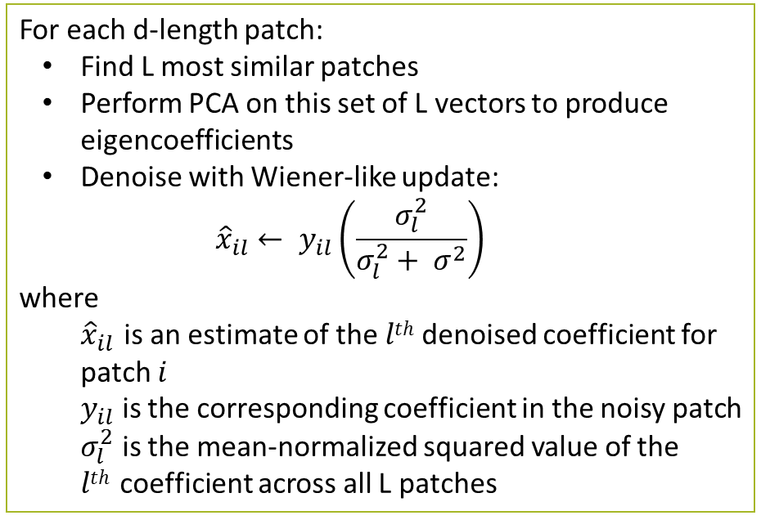
Unknown View Angles: Algorithm (Denoising)
The first step in the algorithm involves denoising the projections, since noisy projections may significantly hamper the efficacy of the following step
Patch-based PCA denoising method
For each d-length patch:
Find L most similar patches
Perform PCA on this set of L vectors to produce eigencoefficients
Denoise with Wiener-like update:
$${\hat{x}}_{il}← y_{il}\left(\frac{σ_{l}^{2}}{σ_{l}^{2}+ σ^{2}}\right)$$
where
${\hat{x}}_{il}$ is an estimate of the $lth$ denoised coefficient for patch $i$
$y_{il}$ is the corresponding coefficient in the noisy patch
$σ_{l}^{2}$ is the mean-normalized squared value of the $lth$coefficient across all L patches
Similar patches can be found in the same projection as well

Slide 19
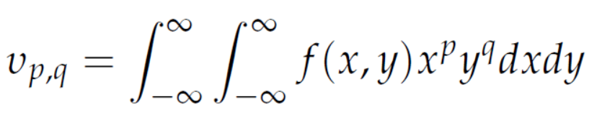
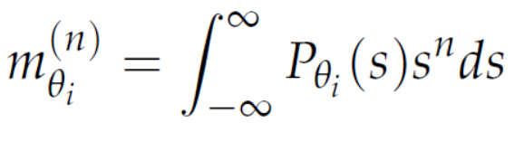
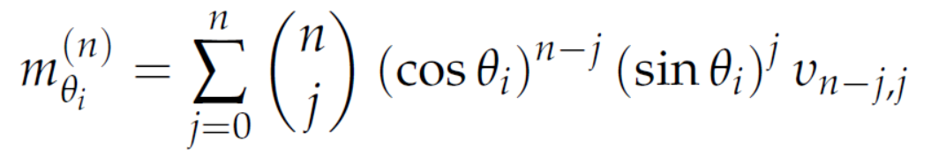
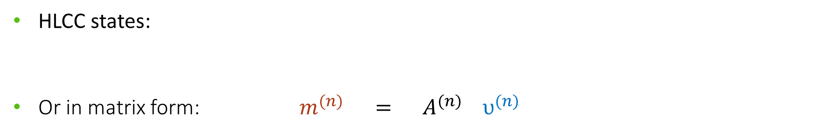
Unknown View Angles: Algorithm (Coordinate Descent)
This algorithm utilizes the Helgasson-Ludwig Consistency Conditions (HLCC)
HLCC describes a relationship between the n^{th} order projection moments and the n^{th} order image moments
Given p projections, the p n^{th}-order projection moments are
Given the underlying image, the (n+1) n^{th}-order image moments are
HLCC states:
Or in matrix form: $m^{(n)} = A^{(n)}{ υ}^{(n)}$

Slide 20
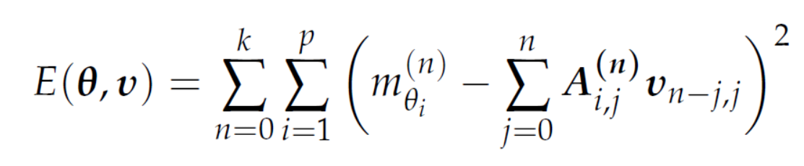
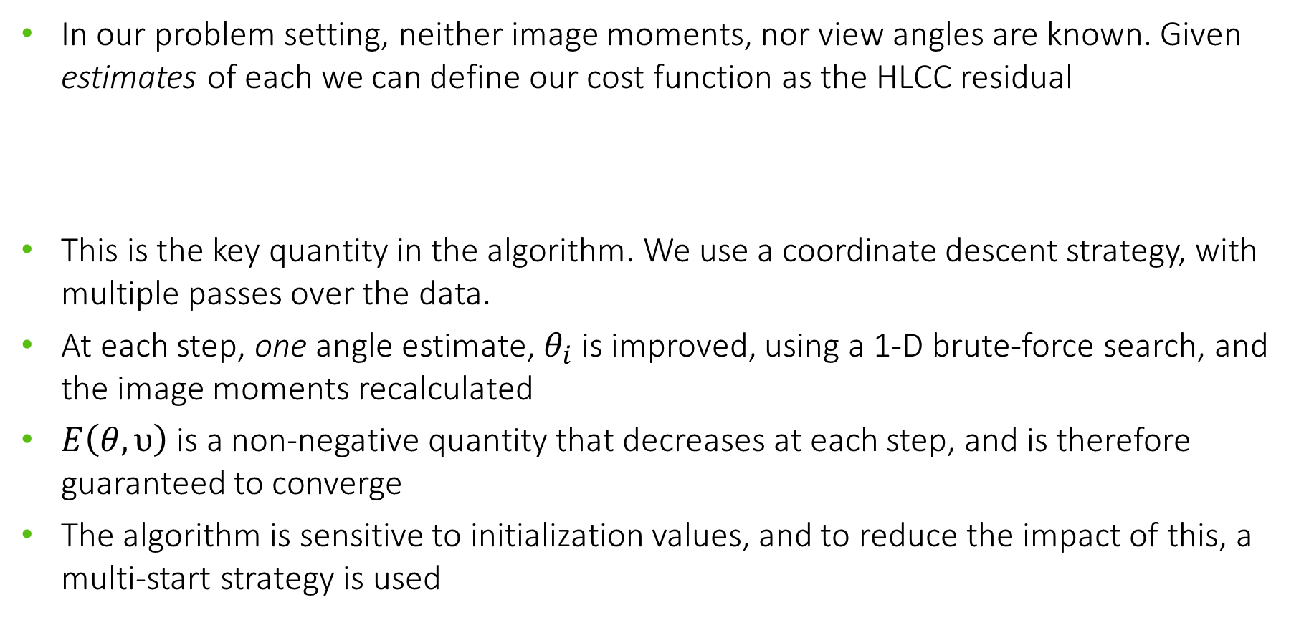
Unknown View Angles: Algorithm (Coordinate Descent)
In our problem setting, neither image moments, nor view angles are known. Given estimates of each we can define our cost function as the HLCC residual
This is the key quantity in the algorithm. We use a coordinate descent strategy, with multiple passes over the data.
At each step, one angle estimate, $θ_{i}$ is improved, using a 1-D brute-force search, and the image moments recalculated
$E\left(θ, υ\right)$ is a non-negative quantity that decreases at each step, and is therefore guaranteed to converge
The algorithm is sensitive to initialization values, and to reduce the impact of this, a multi-start strategy is used

Slide 21
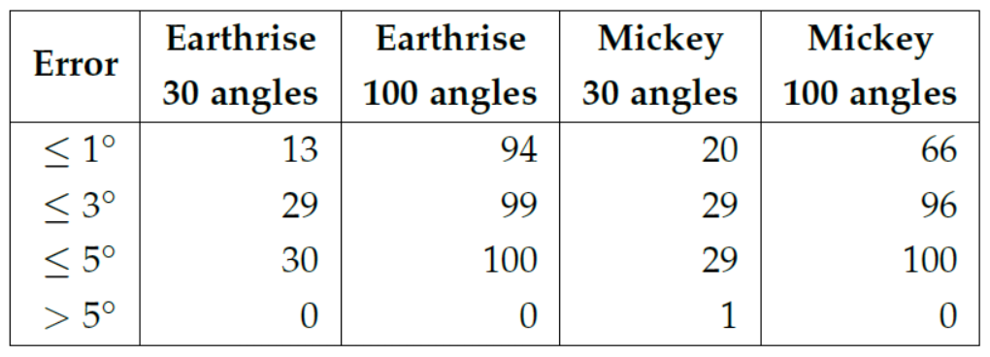
Unknown View Angles: Results
Simulated experiments gave quite good recovery, across multiple images, even with very few angles
Most estimates were off by ≤ 3º, with rare exceptions going above 5º
(Rotational ambiguity was eliminated manually for clearer representation)

Slide 22
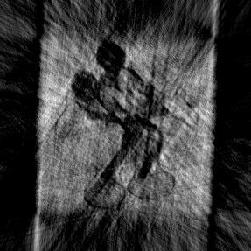
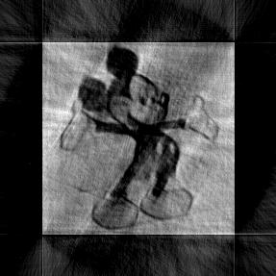
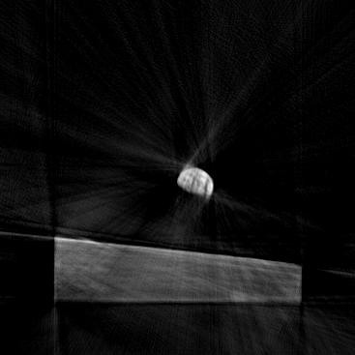
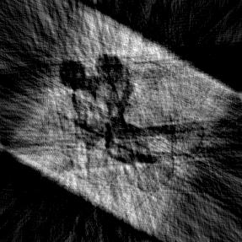
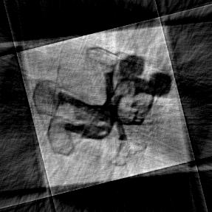
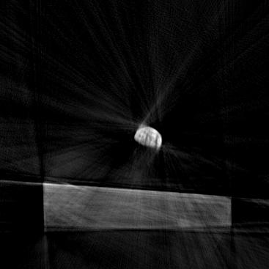
Unknown View Angles: Results
Reconstruction results using FBP
5% noise
Actual angles
Estimated Angles
30 angles
100 angles
100 angles

Slide 23
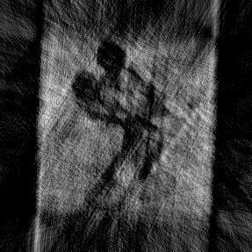
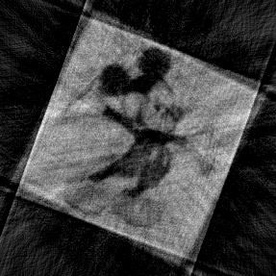

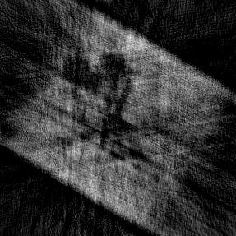
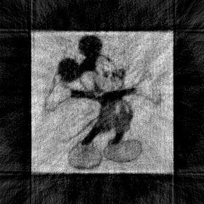
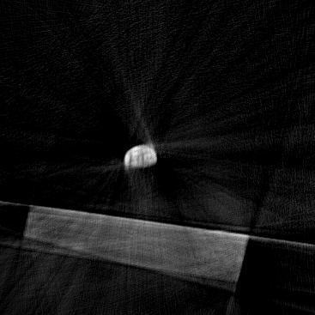
Unknown View Angles: Results
Reconstruction results using FBP
10% noise
Actual angles
Estimated Angles
30 angles
100 angles
100 angles

Slide 24
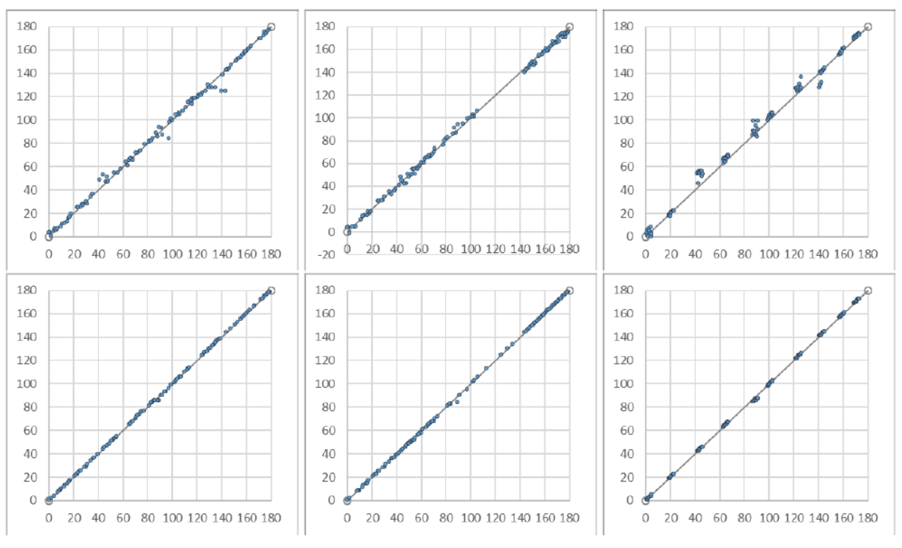
Unknown View Angles: Results
The algorithm also proved to be extremely robust to the distribution from which the angles were taken. Angle recovery under 10% noise:
Uniform
Non-uniform
Peaky
X: True angle value
Y: Estimated angle value
‘mickey’
‘earthrise’
(Rotational ambiguity was eliminated manually for clearer representation)

Slide 25
Unknown View Angles: Conclusions and Future Work
This algorithm extends the angle recovery to scenarios where the projection angles are completely unknown
The recovery is excellent, considering there is zero available knowledge about view angles, and the algorithm is robust. However, the angle errors are not small enough for applications requiring precise measurements
For such scenarios, we propose a pipeline using the Coordinate descent algorithm for obtaining approximate estimates of the angles, followed by fine-tuning using the alternating algorithm described in the first section

Slide 26
Interference Among Sparse Signals
Section 3

Slide 27
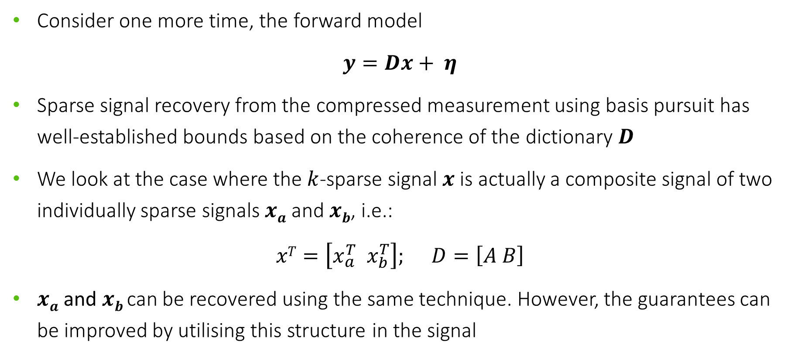
Interference: Background
Consider one more time, the forward model
$$y=Dx+ η$$
Sparse signal recovery from the compressed measurement using basis pursuit has well-established bounds based on the coherence of the dictionary $D$
We look at the case where the $k$-sparse signal $x$is actually a composite signal of two individually sparse signals $xa$ and $xb$, i.e.:
$$xT=\left[x_{a}^{T} x_{b}^{T}\right]; D=\left[A B\right]$$
$xa$ and $xb$can be recovered using the same technique. However, the guarantees can be improved by utilising this structure in the signal

Slide 28
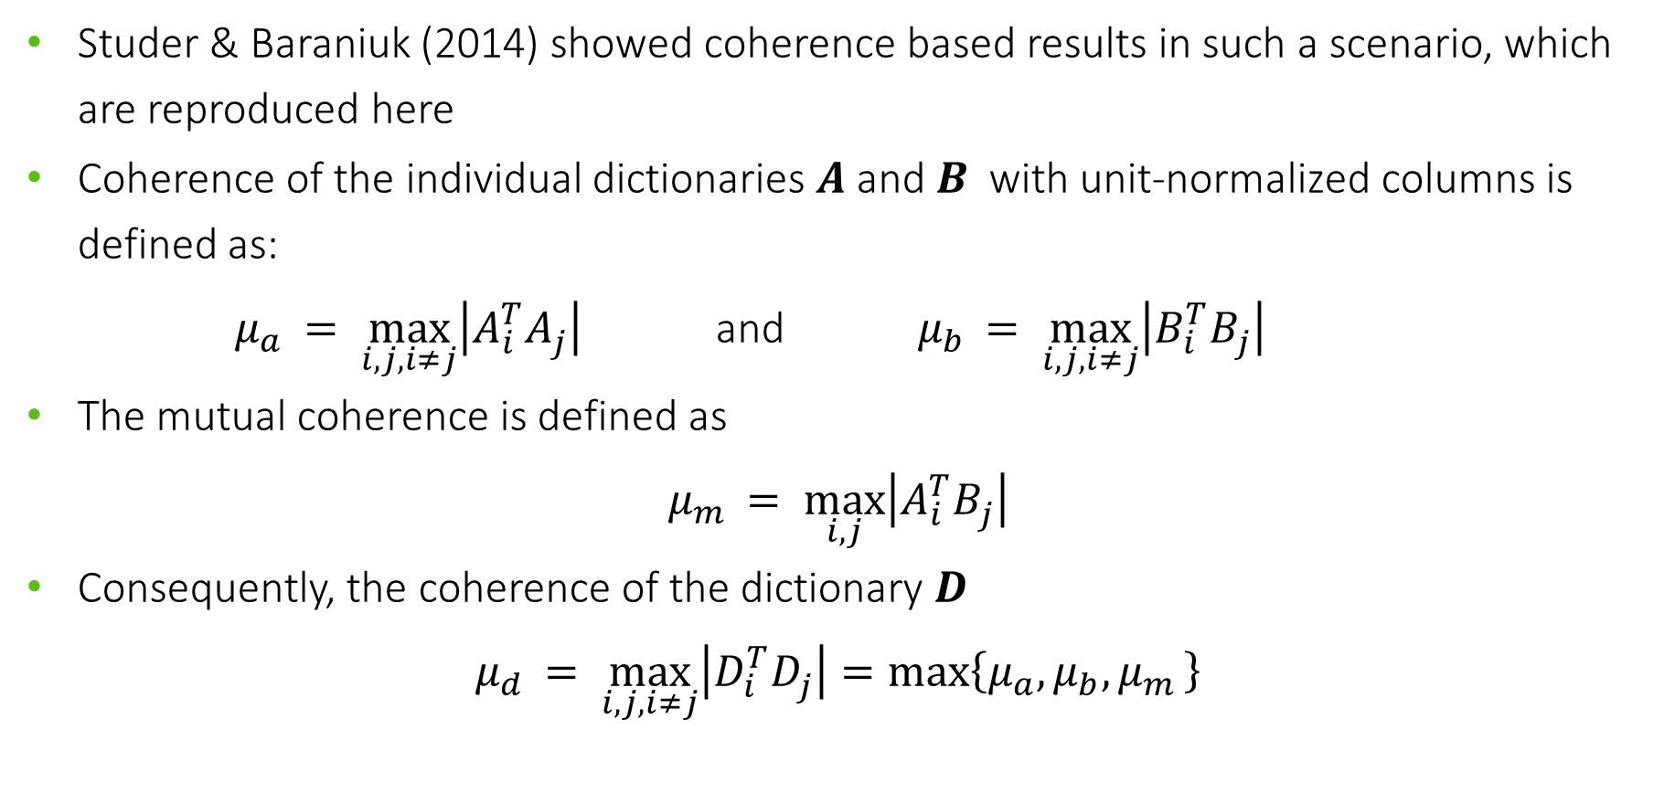
Interference: Background
Studer & Baraniuk (2014) showed coherence based results in such a scenario, which are reproduced here
Coherence of the individual dictionaries $A$ and $B$ with unit-normalized columns is defined as:
$μ_{a }= \max_{i,j,i≠j}\left|A_{i}^{T}A_{j}^{ }\right|$ and $μ_{b }= \max_{i,j,i≠j}\left|B_{i}^{T}B_{j}^{ }\right|$
The mutual coherence is defined as
$$μ_{m }= \max_{i,j}\left|A_{i}^{T}B_{j}^{ }\right|$$
Consequently, the coherence of the dictionary $D$
$$μ_{d }= \max_{i,j,i≠j}\left|D_{i}^{T}D_{j}^{ }\right|=max\left\{μ_{a},μ_{b},μ_{m }\right\}$$

Slide 29
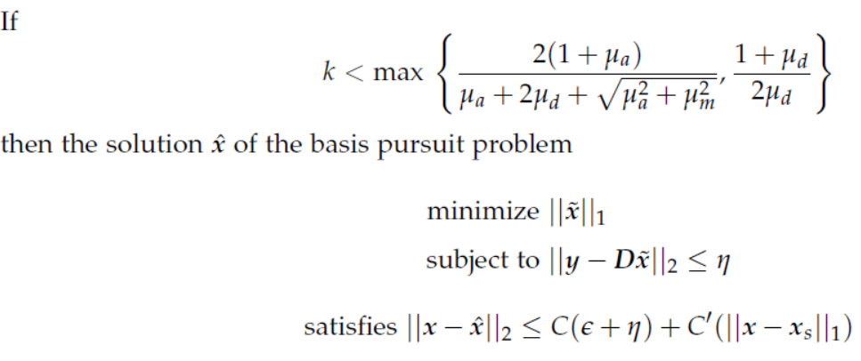
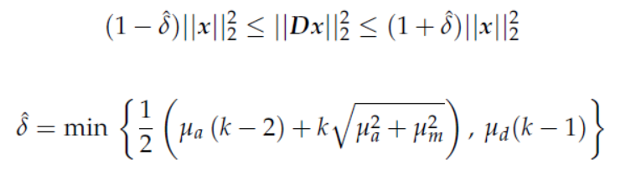

Interference: Background
Studer & Baraniuk show that assuming $μ_{a}≥ μ_{b}$
1.
2.
where

Slide 30
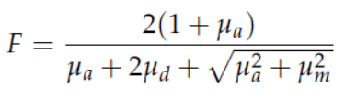
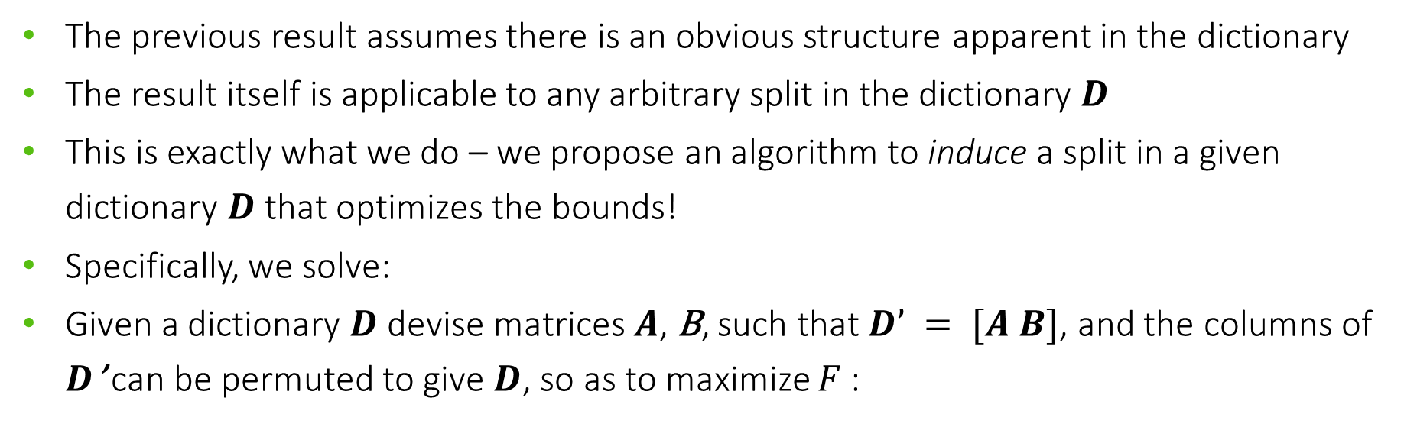
Interference: Problem Statement
The previous result assumes there is an obvious structure apparent in the dictionary
The result itself is applicable to any arbitrary split in the dictionary $D$
This is exactly what we do – we propose an algorithm to induce a split in a given dictionary $D$ that optimizes the bounds!
Specifically, we solve:
Given a dictionary $D$ devise matrices $A$, B, such that $D’ = [A B]$, and the columns of $D$’ can be permuted to give $D$, so as to maximize $F$:

Slide 31
Interference: Algorithm
Equivalent graph problem:
P
P Q R ….
P.Q
P.R
Q
Q.R
R
One node in G corresponding to each column in D
G is fully connected. Edge weight = dot product of the columns connected

Slide 32
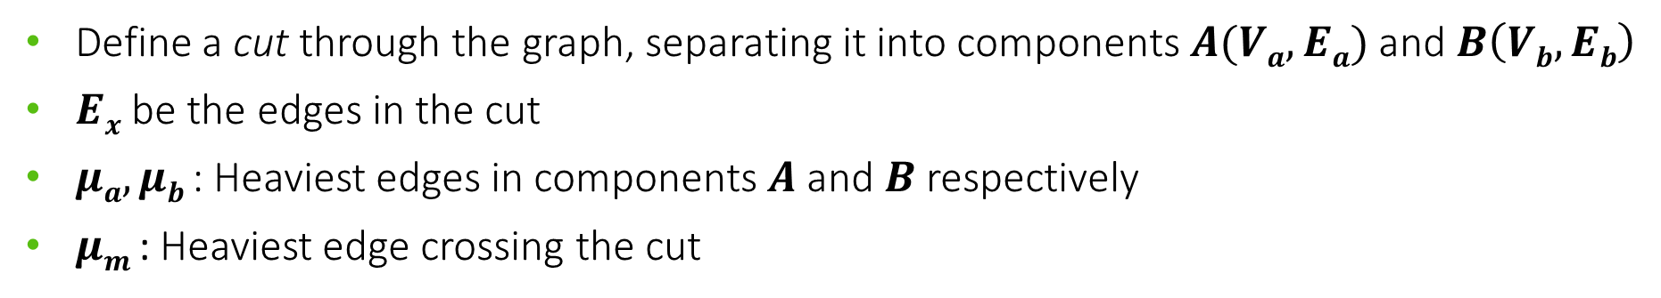
Interference: Algorithm
Equivalent graph problem:
S
P
R
T
Q
U
Define a cut through the graph, separating it into components $A(Va, Ea)$and $B\left(Vb, Eb\right)$
$Ex$ be the edges in the cut
$μa, μb$ : Heaviest edges in components $A$ and $B$ respectively
$μm$ : Heaviest edge crossing the cut

Slide 33
Interference: Algorithm
Algorithm intuition:
This is essentially a greedy algorithm
Start with the highest weight edge in the cut, assigning one node each to parts A and B.
While not all vertices are assigned:
Candidate edges = edges with exactly one end-point assigned.
Pick max weight edge from candidates (say uv, with u assigned).
Assign v to the component that u is not in.

Slide 34
Interference: Algorithm
Example run
S
0
15
P
6
R
18
4
3
7
1
10
Q
T
5

Slide 35
Interference: Algorithm
Example run
S
0
15
P
6
R
18
4
3
7
1
10
Q
T
5

Slide 36
Interference: Algorithm
Example run
S
0
15
P
6
R
18
4
3
7
1
10
Q
T
5
Candidate Edges

Slide 37
Interference: Algorithm
Example run
S
0
15
P
6
R
18
4
3
7
1
10
Q
T
5

Slide 38
Interference: Algorithm
Example run
S
0
15
P
6
R
18
4
3
7
1
10
Q
T
5
Candidate Edges

Slide 39
Interference: Algorithm
Example run
S
0
15
P
6
R
18
4
3
7
1
10
Q
T
5

Slide 40
Interference: Algorithm
Example run
S
0
15
P
6
R
18
4
3
7
1
10
Q
T
5
Candidate Edges

Slide 41
Interference: Algorithm
Example run
S
0
15
P
6
R
18
4
3
7
1
10
Q
T
5

Slide 42
Interference: Algorithm
6
Example run
S
0
15
P
R
18
4
3
7
1
10
Q
T
5

Slide 43
Interference: Algorithm
Corresponding dictionary split
P Q R S T
P R S Q T
A
B

Slide 44
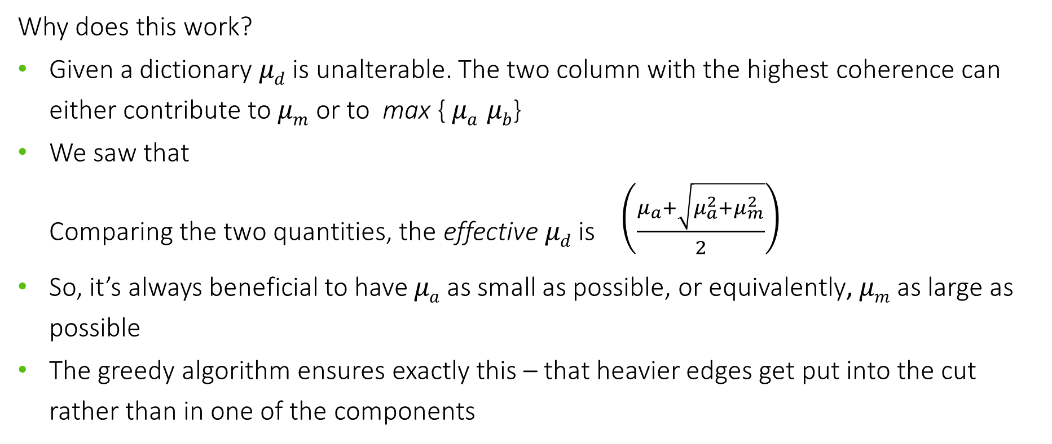
Interference: Algorithm
Why does this work?
Given a dictionary $μd$ is unalterable. The two column with the highest coherence can either contribute to $μm$ or to max { $μa μb$}
We saw that Comparing the two quantities, the effective $μd$ is $\left(\frac{μ_{a}+\sqrt{μ_{a}^{2}+μ_{m}^{2}}}{2}\right)$
So, it’s always beneficial to have $μa$ as small as possible, or equivalently, $μm$ as large as possible
The greedy algorithm ensures exactly this – that heavier edges get put into the cut rather than in one of the components
(Full proof of optimality in appendix)

Slide 45
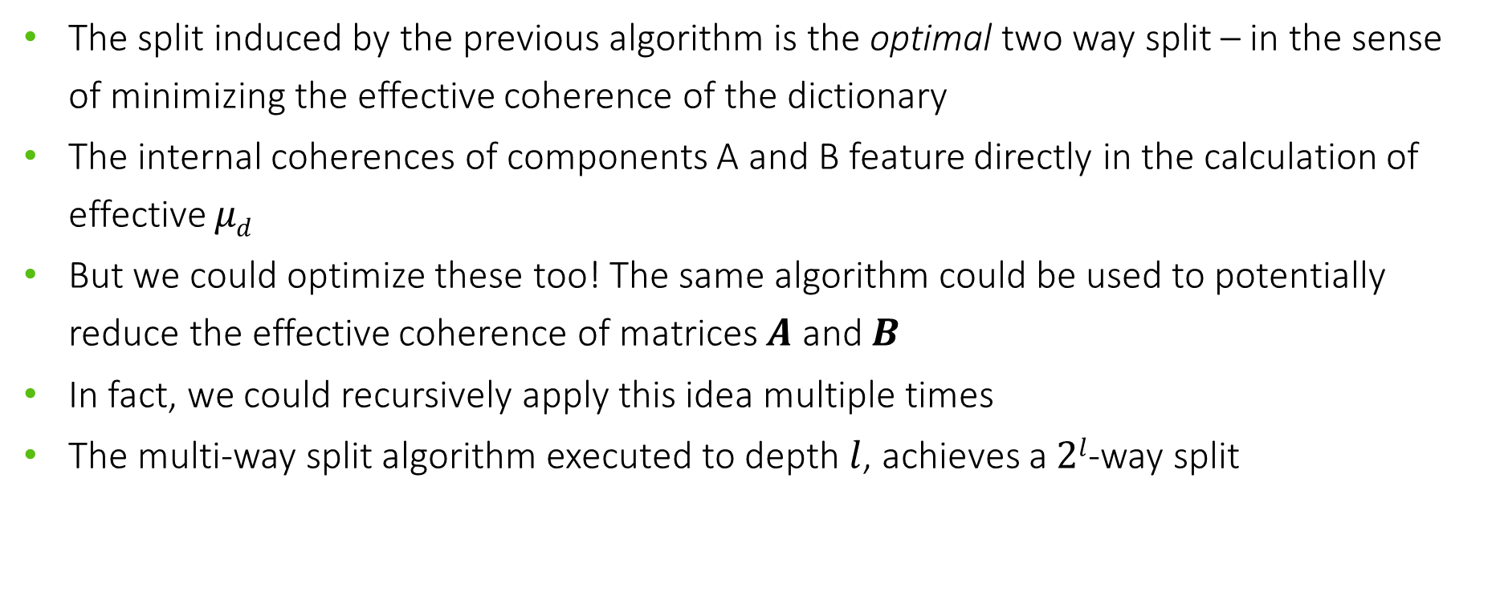
Interference: Higher order recursive algorithm
The split induced by the previous algorithm is the optimal two way split – in the sense of minimizing the effective coherence of the dictionary
The internal coherences of components A and B feature directly in the calculation of effective 𝜇_{𝑑}
But we could optimize these too! The same algorithm could be used to potentially reduce the effective coherence of matrices $A$ and $B$
In fact, we could recursively apply this idea multiple times
The multi-way split algorithm executed to depth $l$, achieves a $2l$-way split

Slide 46
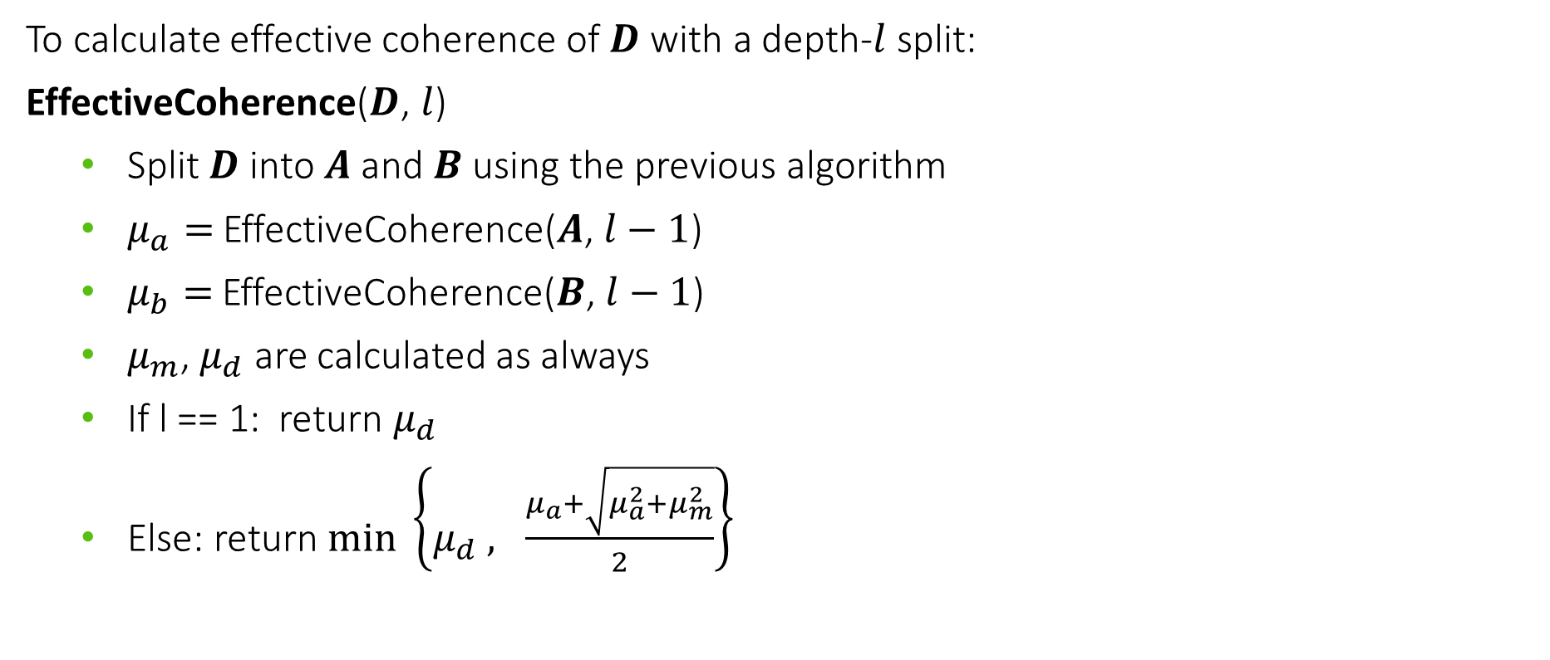
Interference: Higher order recursive algorithm
To calculate effective coherence of $D$ with a depth-$l$ split:
EffectiveCoherence($D$, $l$)
Split $D$ into $A$ and $B$ using the previous algorithm
$μ_{a}=$EffectiveCoherence($A$, $l−1$)
$μ_{b}=$EffectiveCoherence($B$, $l−1$)
$μ_{m}$, $μ_{d}$ are calculated as always
If l == 1: return $μ_{d}$
Else: return $\min_{ }\left\{μ_{d} , \frac{μ_{a}+\sqrt{μ_{a}^{2}+μ_{m}^{2}}}{2}\right\}$

Slide 47
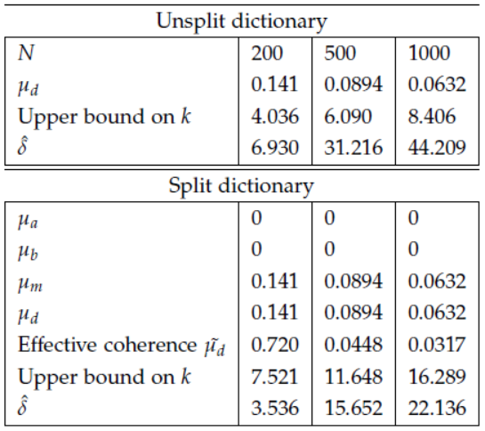
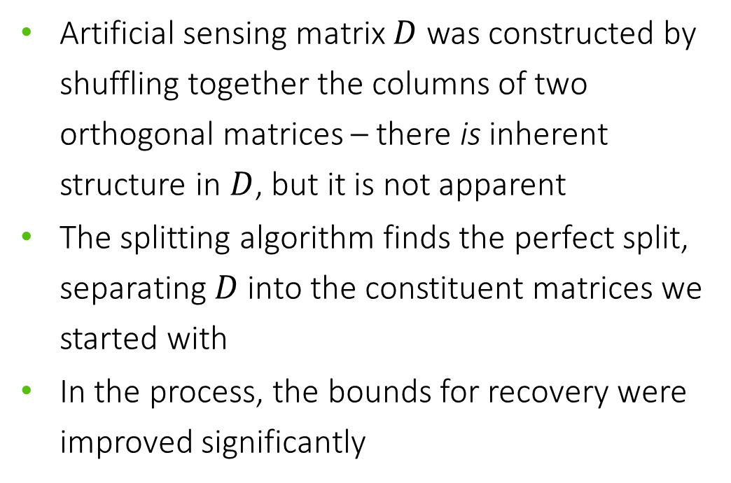
Interference: Results
Artificial sensing matrix $D$ was constructed by shuffling together the columns of two orthogonal matrices – there is inherent structure in $D$, but it is not apparent
The splitting algorithm finds the perfect split, separating $D$ into the constituent matrices we started with
In the process, the bounds for recovery were improved significantly

Slide 48
Interference: Conclusions and Future Work
The two-way split algorithm finds the optimal induced split in the dictionary.
Unfortunately, this is not true of the recursive algorithm. However, it is guaranteed to be at least as good as the two-way split algorithm, since that case is subsumed here.
Note that in either case, the recovery algorithm is unchanged. But we have improved the bounds on recovery for a given dictionary
Future avenues of work include developing a multi-way splitting algorithm that is optimal, in terms of recovery bounds

Slide 49
Thank You

Slide 50
Appendix

Slide 51
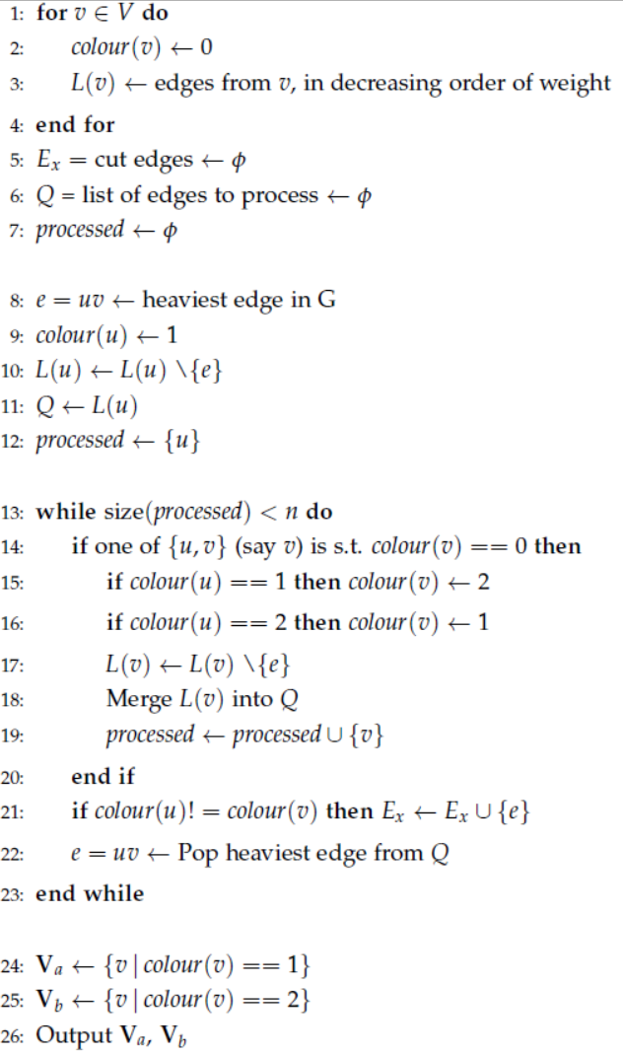
Complete Dictionary Splitting Algorithm

Slide 52
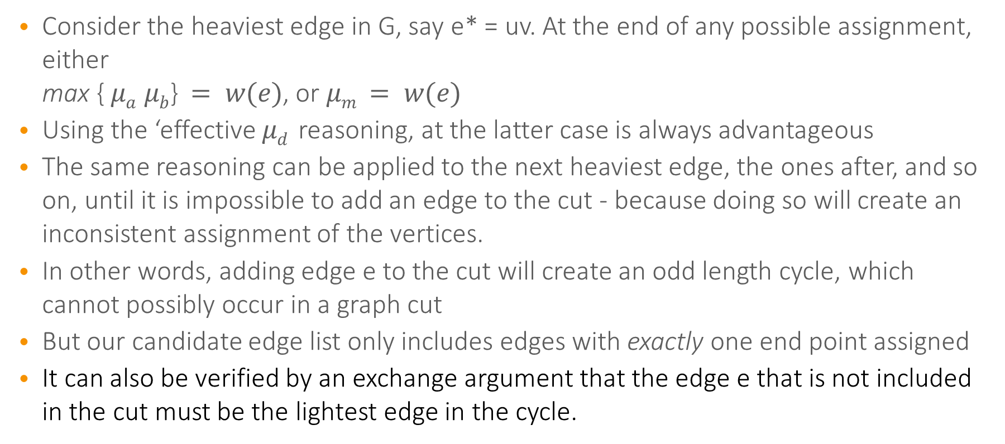
Optimality of Two-way Splitting Algorithm
Consider the heaviest edge in G, say e* = uv. At the end of any possible assignment, either max { $μa μb$} $= w(e)$, or $μm$ $= w(e)$
Using the ‘effective $μd$ reasoning, at the latter case is always advantageous
The same reasoning can be applied to the next heaviest edge, the ones after, and so on, until it is impossible to add an edge to the cut - because doing so will create an inconsistent assignment of the vertices.
In other words, adding edge e to the cut will create an odd length cycle, which cannot possibly occur in a graph cut
But our candidate edge list only includes edges with exactly one end point assigned
It can also be verified by an exchange argument that the edge e that is not included in the cut must be the lightest edge in the cycle.

